Slide 1
An adaptation of hybrid binary optimization algorithms for medical image feature selection in neural network for classification of breast cancer

Slide 2
Adjustments to Compartmental
Adjustments
1. To prevent no individuals in been infected we prevent individual from recovery or death supposed only one person is infected. To prevent early convergence. And aid exploration.
2. If we are all get infected we recover 50 percent of the entire population. To enable exploration of more features in the compartmental model

Slide 3
Suggested
BDMO
BPSO
ACO
BSO
BSA
FFA

Slide 4
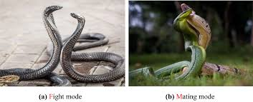
What is Snake optimizer
The Snake Optimization Algorithm (SO) is a nature-inspired metaheuristic optimization algorithm that mimics the foraging and reproductive behaviours of snakes to solve complex optimization problems.
Proposed by Hashim and Hussien in 2022, SO simulates how snakes search for food, fight, and mate under varying environmental conditions (e.g., food availability and temperature)

Slide 5
Research Document by: Xinyu Bao, Hui Kang & Hongjuan Li : Published 2024
This focuses on the use of SO as a mechanism for feature feature selection and or solving optimization problems
We employ the mechanisms used by this paper for calculating
1. Temperature ( temp)
2. Food quantity (Q)
And other factors used for randomised conditions for feature selection.
3. Other parameters thus( thresholds needed for the algorithm to work)

Slide 6
Why BSO
Complementary Search Strategies
BSO balances exploration (Q < 0.25) and exploitation (Q ≥ 0.25).
HBEOSA uses Ebola-inspired dynamics for search.
Benefit: Enhances exploration and refines feature subsets.
Enhanced Solution Diversity
BSO’s fight/mating modes promote diverse feature combinations.
HBEOSA’s infection/recovery adds unique dynamics.
Benefit: Reduces redundant or suboptimal feature subsets.
High-Dimensional Efficiency
BSO navigates large feature spaces effectively.
HBEOSA excels in binary optimization.
Benefit: Scales well for high-dimensional datasets

Slide 7
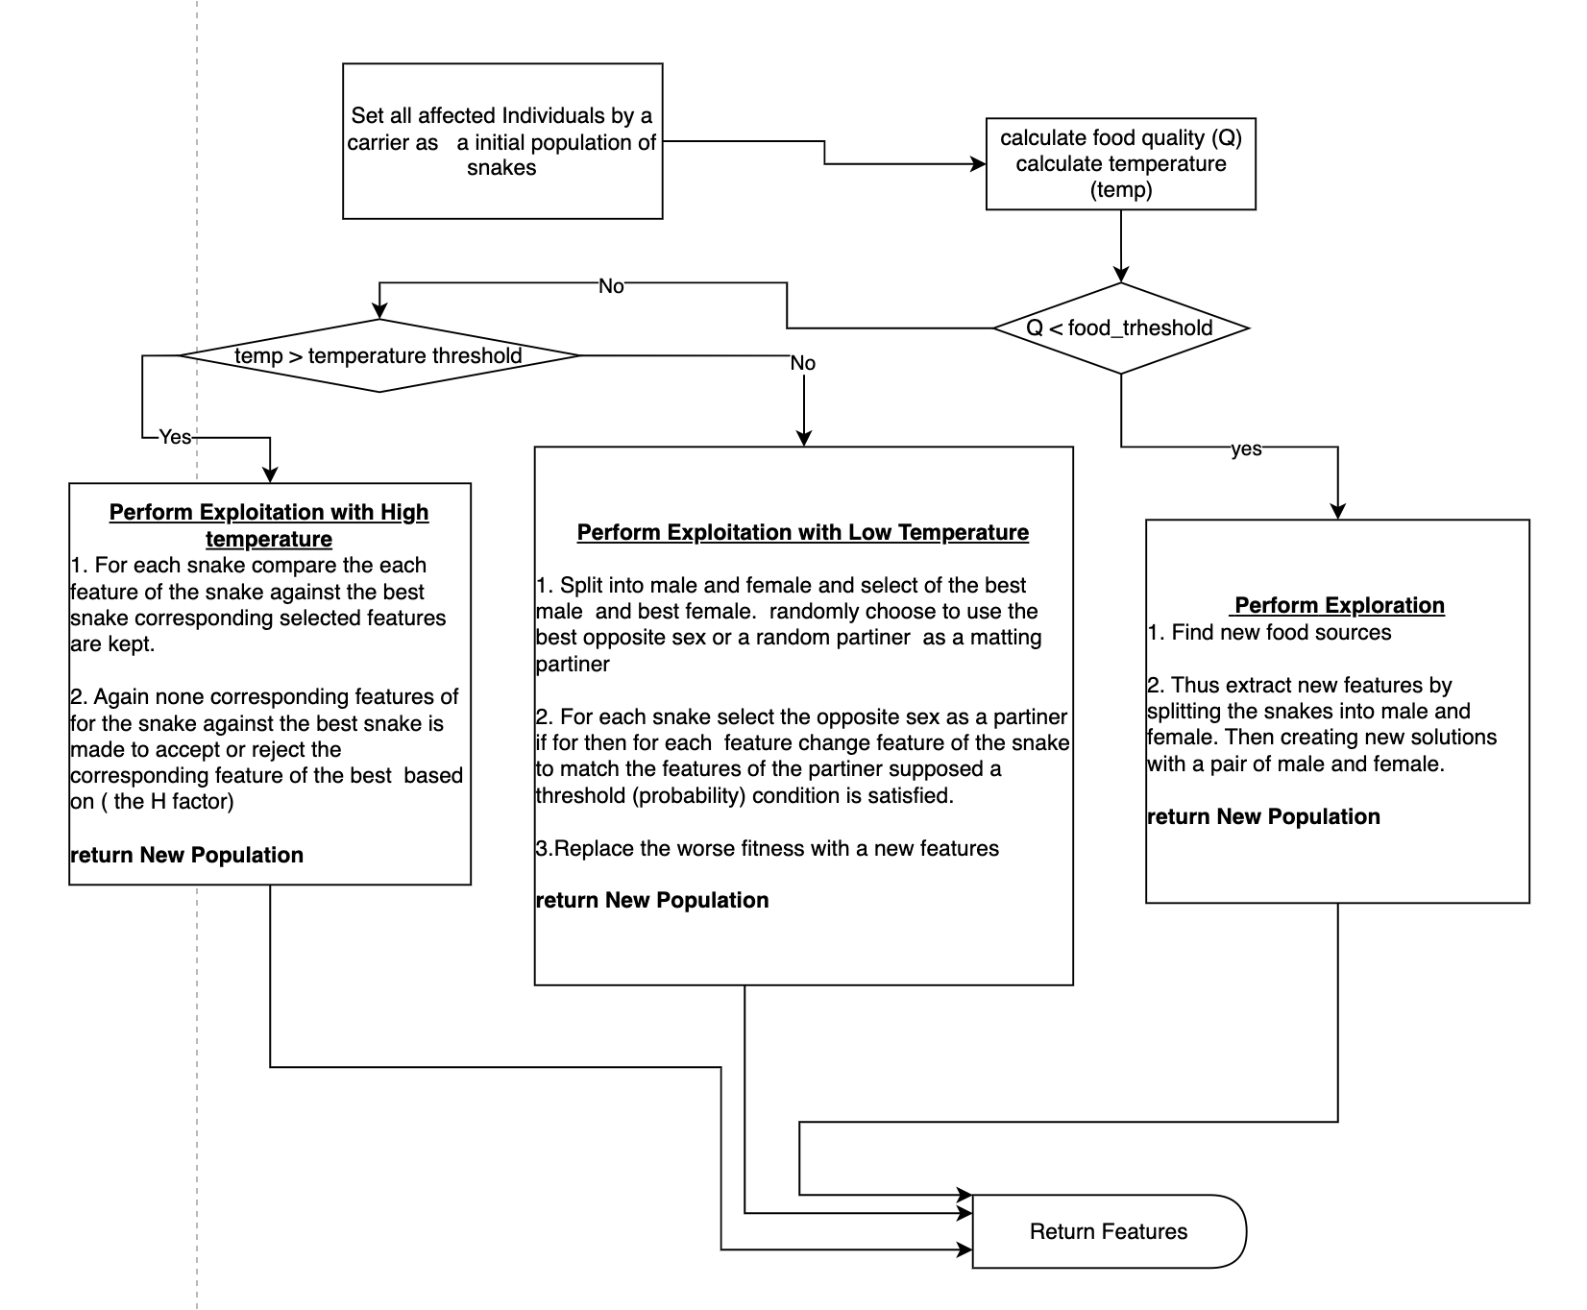
Flow Chat For intergration

Slide 8
ACO ( Ant Colony Optimization )

